Slide 1
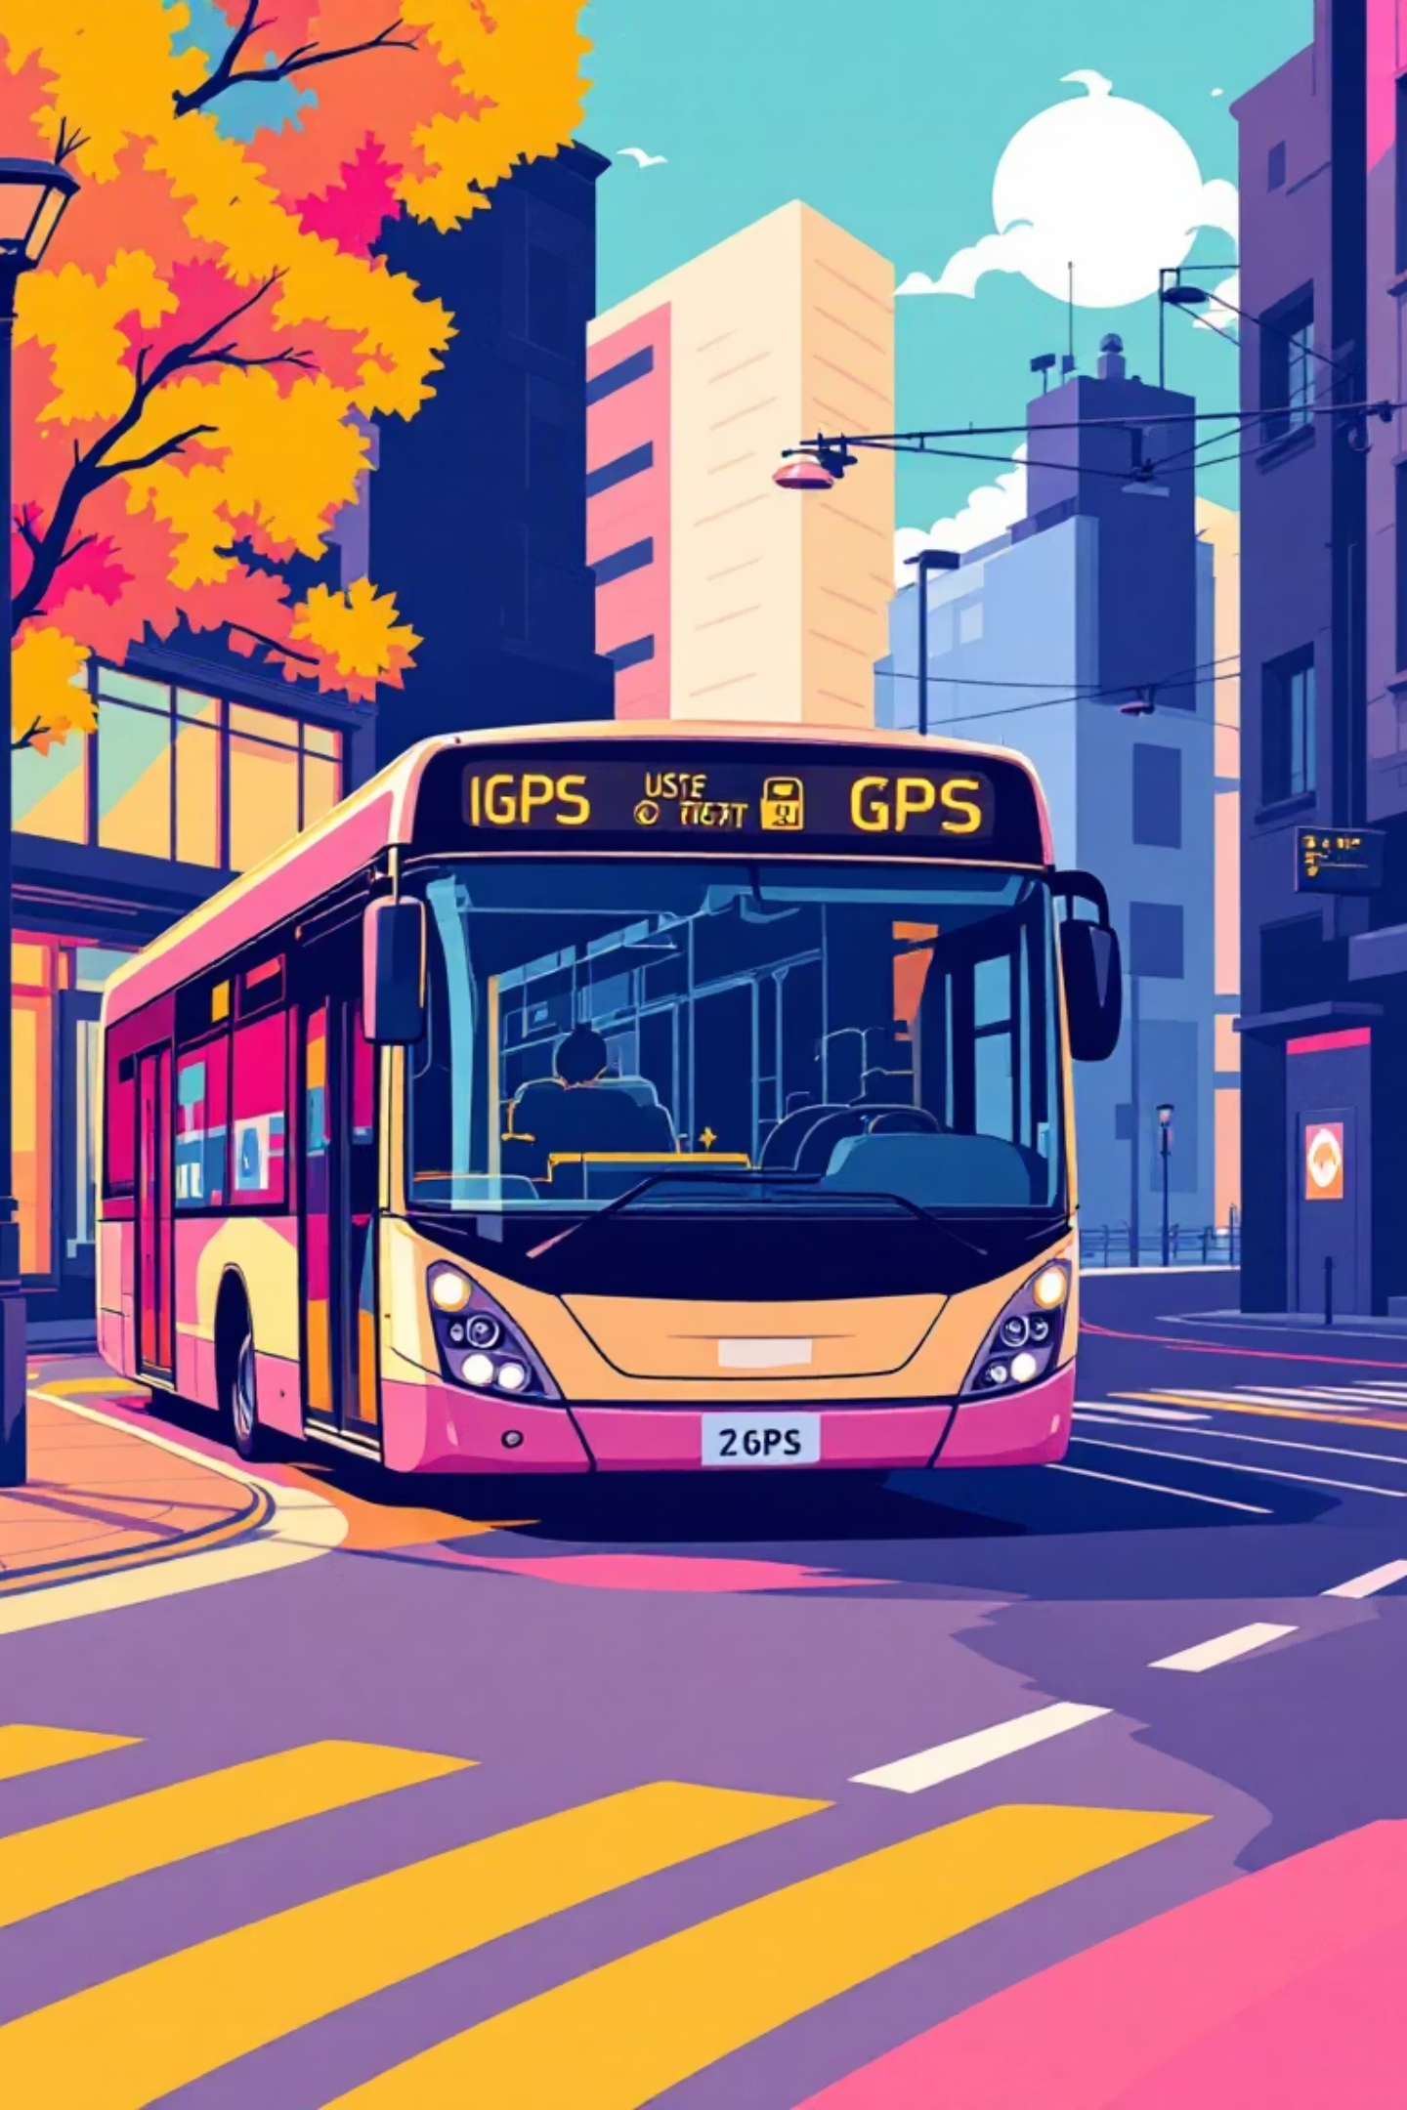
Public Transport Tracking & Management System
An intelligent full-stack platform revolutionizing public transportation through real-time tracking, AI-powered predictions, and seamless digital booking—will be designed for efficiency, transparency, and universal accessibility.

Slide 2








Project Overview
Live GPS Tracking
AI-Powered ETAs
Will enable real-time bus location monitoring with precision mapping
Machine learning algorithms will predict accurate arrival times
Digital Booking
Smart Dashboards
Will offer a seamless online fare payment and seat reservation system
Will provide comprehensive admin and driver control panels
Key Features
Technical Foundation
Will integrate real-time traffic for route optimization
Will employ containerized deployment with Docker
Will implement SMS alerts to ensure rural region connectivity
Will implement JWT authentication and secure API flows
Will utilize a microservices architecture for scalability
Will use MongoDB for robust data management

Slide 3

The Development Team's Upcoming Work
A multidisciplinary team will combine expertise in AI/ML research, backend engineering, DevOps infrastructure, and system architecture to deliver a comprehensive transportation solution.
01
AI & Research
The team will develop machine learning models and create scientific documentation.
02
Backend Architecture
The team will develop APIs, design databases, and integrate systems.
03
DevOps & Deployment
The team will implement containerization, build CI/CD pipelines, and manage production infrastructure.
04
System Engineering
The team will implement and optimize end-to-end features.

Slide 4

Kaviyadharshini
AI/ML Engineering & Research
Research Leadership
1
Will spearhead comprehensive research into ETA prediction algorithms, evaluating multiple approaches including regression models, neural networks, and ensemble methods to identify optimal solutions for real-world transit scenarios.
ML Pipeline Design
2
Will architect an end-to-end machine learning pipeline utilizing advanced regression techniques, feature engineering, and model validation frameworks to ensure prediction accuracy and robustness.
Data Processing
3
Will clean and preprocess extensive datasets including historical GPS coordinates, traffic patterns, and route information—handling missing values, outliers, and temporal dependencies for model training.
Scientific Documentation
4
Will prepare comprehensive research documentation detailing methodology, experimental results, and performance metrics for potential publication and patent applications.

Slide 5






Kaviyadharshini
Backend Integration & Deployment
FastAPI Microservice
Will integrate ML prediction service with Node.js backend using RESTful APIs and efficient data serialization
Prediction Endpoints
Will develop scalable backend endpoints serving real-time ETA predictions with sub-second response times
Deployment Workflows
Will configure CI/CD pipelines for automated testing, model versioning, and seamless AIML service deployment
API Integration
Will contribute to routing logic, request validation, and error handling across backend infrastructure
Key Planned Outcome: Will successfully bridge machine learning models with production backend, enabling real-time intelligent predictions at scale.

Slide 6
Vinod
Patent Development & Machine Learning Innovation
Patent-Ready Architecture
Core ETA Engine
Anomaly Detection
Rural Optimization
Will build sophisticated prediction engine combining machine learning models with real-time traffic feeds, weather data, and historical patterns for unprecedented accuracy.
Will develop intelligent system identifying off-route buses, unexpected delays, and service disruptions using unsupervised learning techniques.
Will engineer specialized algorithms addressing unique challenges of rural routes—handling sparse GPS data, unpaved roads, and variable traffic conditions.
Will design innovative workflow for predictive transit system with novel integration of ML, traffic data, and GPS tracking—which will position the platform for intellectual property protection.

Slide 7

Vinod
Backend Architecture & DevOps Infrastructure
System Architecture
Security & Automation
Will design comprehensive backend structure encompassing routes, real-time tracking, booking management, and user authentication with RESTful principles and modular organization.
Will implement JWT-based authentication, scheduled cron jobs for data synchronization, and an intelligent alert engine for passenger notifications and system monitoring.
Containerization Strategy
Will architect a complete Docker containerization strategy—for backend services, frontend application, MongoDB database, and ML microservices—ensuring consistency across environments.
"Will build production-ready Docker Compose orchestration, enabling one-command deployment with automatic scaling, health checks, and zero-downtime updates."

Slide 8

Sagar
Backend Engineering & API Development
1
Core API Development
Will engineer comprehensive RESTful APIs for vehicle management, route planning, booking workflows, and user authentication with robust input validation.
2
Database Architecture
Will design MongoDB schema models with optimized relations, embedded documents, and reference patterns, ensuring data integrity and query performance.
3
Live Location System
Will integrate driver location update mechanisms using GPS coordinates, timestamps, and geospatial queries for real-time tracking visualization.
4
Security & Performance
Will implement secure API flows with authentication middleware, rate limiting, and will optimize database queries for high-frequency operations.
Technical Stack
Node.js with Express framework
MongoDB with Mongoose ODM
Real-time WebSocket connections
Will optimize database indexing

Slide 9

Sagar
Admin Systems & Analytics Backend
Route Management Console
Analytics & Reporting
Will develop administrative endpoints enabling route creation, modification, and deletion with validation rules, schedule management, and conflict detection for operational efficiency.
Will build comprehensive backend modules generating ridership statistics, revenue reports, performance metrics, and predictive insights using aggregation pipelines and data analytics frameworks.
System Validation
Query Optimization
Will implement system-wide validation schemas, custom error handling middleware, and logging infrastructure to ensure data quality and facilitate debugging across all services.
Will optimize database queries for high-frequency tracking updates using indexing strategies, caching mechanisms, and efficient data structures, aiming to reduce response times by 60%.

Slide 10

Dhanush
Trip Management & Booking Infrastructure
Seat Allocation Engine
1
Will implement a dynamic seat allocation system with real-time availability tracking and conflict prevention
2
Fare Calculator
Will develop an intelligent pricing engine considering distance, route type, and passenger categories
Trip Lifecycle APIs
3
Will create a comprehensive trip management system with status updates, notifications, and cancellation handling
4
Integration Layer
Will connect the booking system with vehicle, route, and user modules, ensuring seamless data flow
Route Mapping
5
Will build ETA calculation and route visualization functions, integrating with ML prediction services
Planned Outcomes
Anticipated Impact: Will engineer a booking infrastructure capable of handling 10,000+ concurrent transactions with zero data inconsistencies.
Will achieve sub-second booking confirmation processing
Plans for 99.9% accuracy in seat availability tracking
Will ensure seamless integration with payment gateways

Slide 11






Dhanush
Integration & Notifications
ML Microservice Integration
Will seamlessly connect the core backend with the ML ETA microservice, to enable real-time predictive analytics for accurate arrival estimations.
Notification System Logic
Will implement comprehensive backend logic for critical SMS and email notifications, to ensure timely communication for trip updates, bookings, and alerts.
Driver Tracking Sync
Will develop robust synchronization mechanisms for driver tracking, to ensure accurate and live location data across the platform for enhanced operational oversight.
Cross-Module Data Flow
Will orchestrate efficient and seamless data flow across all system modules, to guarantee consistency and reliability of information exchange.

Slide 12
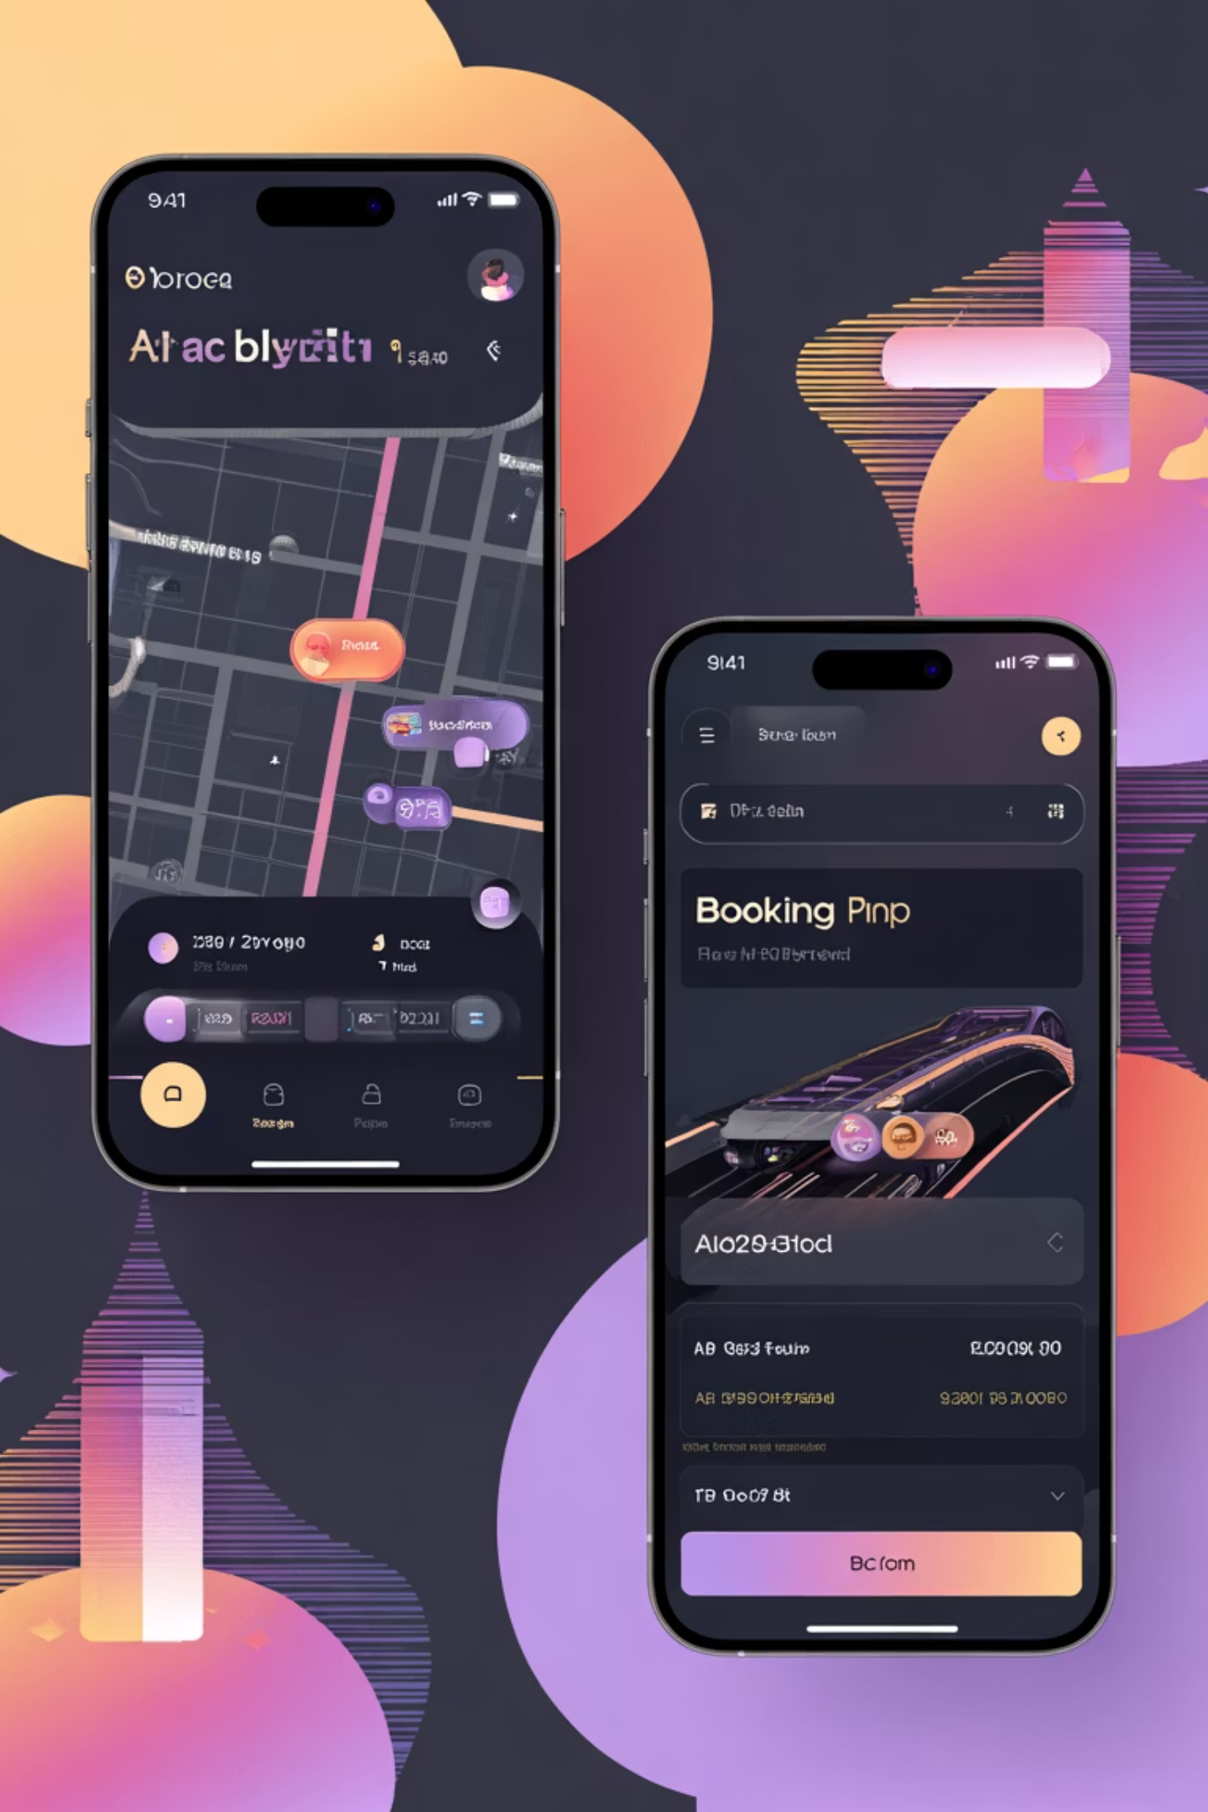




SENIM
Frontend Development
Intuitive React User Interface
Will develop the complete user-facing application using React, to ensure a modern, responsive, and highly interactive experience for passengers.
Seamless Booking & Payments UI
Will design and implement user interfaces for the entire booking journey, including route selection, seat reservations, and secure payment processing.
Real-time Live Tracking Map
Will integrate Leaflet.js to create an interactive map displaying live vehicle locations, estimated arrival times, and route progression for passengers.
Cross-Device Responsiveness
Will ensure optimal viewing and interaction across all screen sizes and devices, to deliver a consistent and user-friendly experience on desktop, tablet, and mobile.

Slide 13

SENIM
User Experience & Admin UI
Admin Panel Development
Will build comprehensive admin panel pages for efficient route and vehicle management, enhancing operational oversight.
Scalable Architecture
Will design a robust, component-based frontend architecture for the admin UI, ensuring modularity and long-term scalability.
Real-time Data Integration
Will seamlessly integrate APIs, interactive maps, and real-time data displays into the admin interface for dynamic insights.
Accessible Design
Will ensure the admin UI is highly accessible, optimizing performance and usability for rural users and those with low-spec devices.

Slide 14









Priyanshu
Frontend Engineering
Will develop intuitive driver dashboard components, providing essential real-time information and controls for efficient trip management.
Will create user interfaces for live trip updates and real-time GPS tracking controls, ensuring drivers have accurate navigation and operational data.
Will implement responsive layouts and develop a library of reusable UI components for consistent design and accelerated feature development.
Will optimize application loading performance and data synchronization for low-network regions, ensuring smooth operation in diverse connectivity environments.

Slide 15

Priyanshu
SMS Alerts & Rural UI
SMS Notification Preferences
Will implement user-friendly interfaces for opting into and out of SMS alerts, which will empower passengers to manage their communication preferences easily.
Optimized Rural Booking
Will develop a streamlined booking experience tailored for rural users, ensuring functionality and ease of use even with limited internet access and basic devices.
Accessible Alert Settings
Will design a clean and intuitive alert settings page, making it simple for all users to customize their notification preferences without complexity.
Integrated Alert Visibility
Will seamlessly incorporate visual alert indicators into the 'My Bookings' and 'Track' screens, providing immediate status updates and critical information at a glance.

